Slide 1
AI IN MILITARY

Slide 2
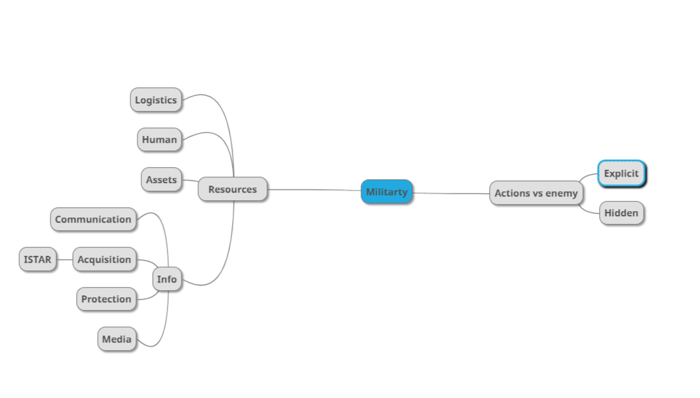

Slide 3
